Slide 1


Future infrastructure projects in the Capital Region and Eastern Zealand
Funded by the EU Horizon 2020 programme
Henning Sten Hansen
Aalborg University Copenhagen
hsh@plan.aau.dk

Slide 2
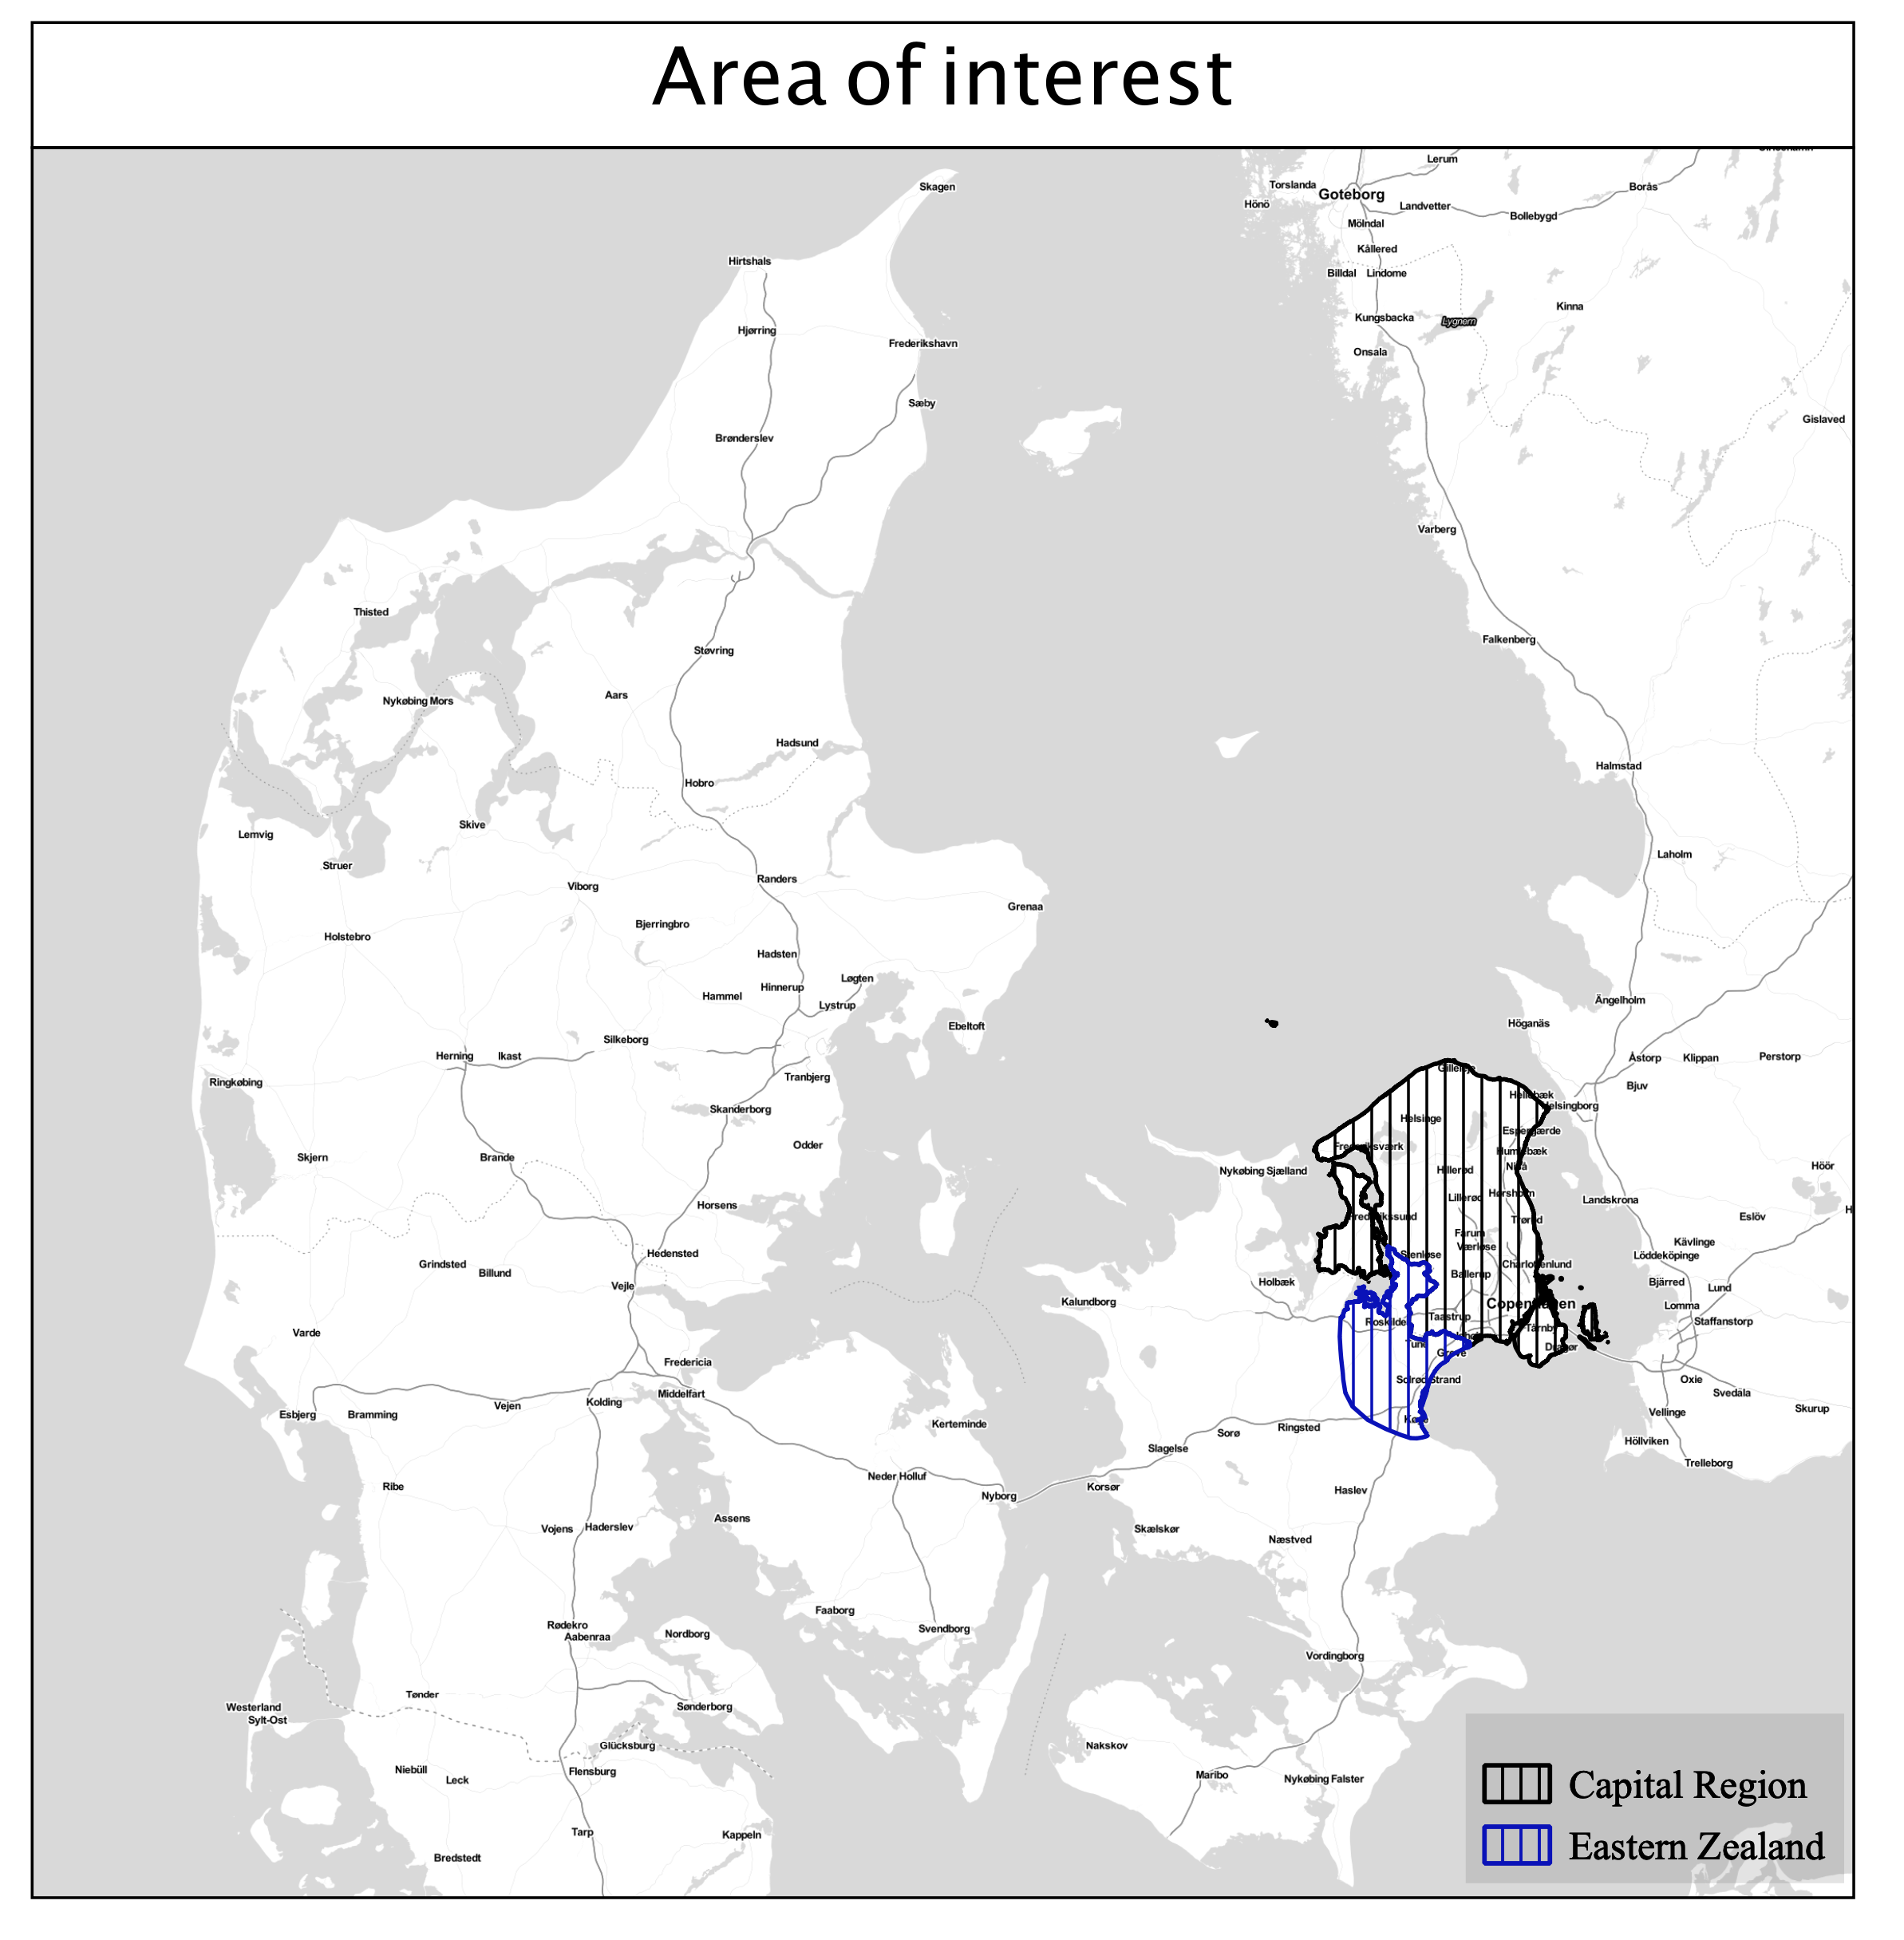

Funded by the EU Horizon 2020 programme

Slide 3
Future projects
Project in progress | Potential project
The Copenhagen Metro (Københavns Metro) | Western transport corridor (Ring 5) (Vestlig transportkorridor (Ring 5))
The Copenhagen Light Rail (Hovedstadens Letbane) | Eastern Ringway (harbour tunnel) (Østlig ringvej (havnetunnel))
Lynetteholmen (a new district in CPH and central for many new transport infrastructure projects) | New train connection Roskilde - Kastrup (Ring South) (Ny togforbindelse Roskilde - Kastrup (Ring Syd))
North harbour tunnel (Nordhavnstunnel) | Light Rail via Frederikssundsvej (Letbane via Frederikssundsvej)
STRING (connection of Femern) ÷ (STRING (Femernforbindelsen)) | The extension of Frederikssunds- and Hillerød motorway (two separate projects) (Forlængelse af Frederikssunds- og Hillerød Motorvejen)
Greater Copenhagen Trafikcharter ÷ | Extension of Farum S-train line to Hillerød (Forlængelse af Farum S-tog til Hillerød)
 | Extension of the metro (Forlængelse af metroen)
 | Øresundsmetro ÷
The table illustrates future infrastructure projects divided into two categories; 'project in progress' and 'potential projects’.
The ÷ describes projects which extent beyond the ‘area of interest’ and are not described further.
The next couple of slides will go through some of the projects.
Funded by the EU Horizon 2020 programme

Slide 4
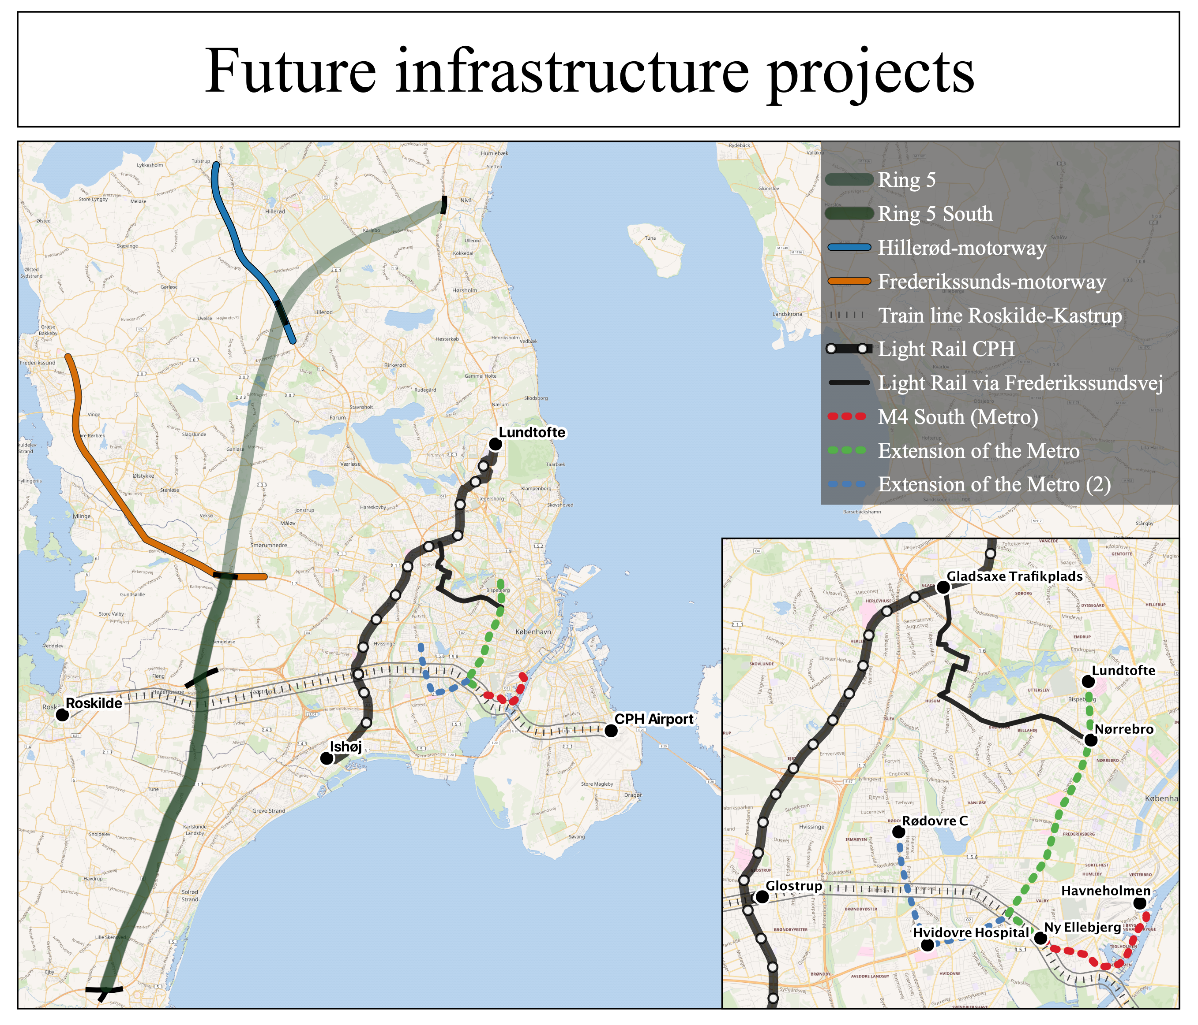
The infrastructure projects are illustrated on the map (except from the Lynetteholmen, North harbour tunnel, Eastern Ringway and the ÷ projects).
Three places which will (potentially) become ‘new’ mobility hubs are Glostrup- and Nørrebro-, Ny Ellebjerg station, currently facilitating S-trains. As the map illustrates, these three places will be intersections of Metro, Light Rail, Regional- and S-train infrastructure.
Funded by the EU Horizon 2020 programme

Slide 5
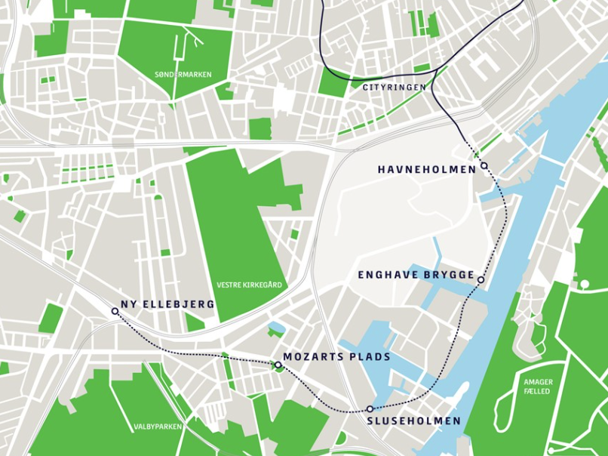
Metro M4 South
The M4 metro line connects the newer parts of Copenhagen from North harbour (Nordhavn) to South harbour (Sydhavn), and is still not finished in the latter area. Five stations on the M4 line will open in 2024 in the South harbour (see map).
Source: Web 1
Funded by the EU Horizon 2020 programme

Slide 6
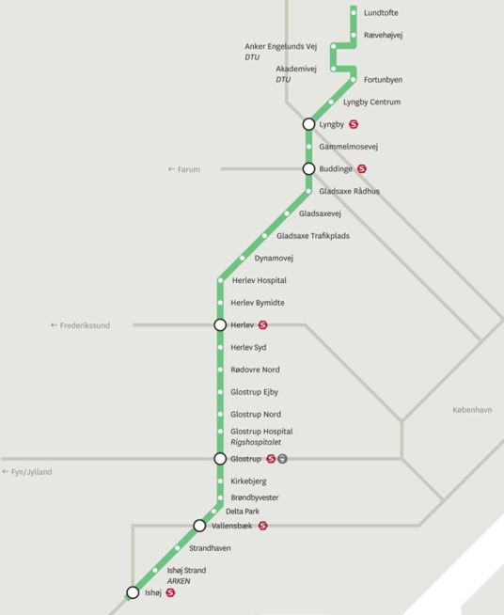
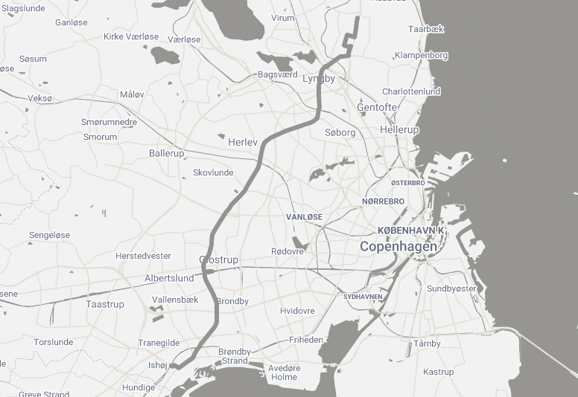
The Copenhagen Light Rail
The Light Rail covers more than 28km between Ishøj and Lyngby stopping at 29 stations (out of which 6 are connected to S-train stations ), linking the suburbs of Copenhagen crosswise.
Funded by the EU Horizon 2020 programme

Slide 7
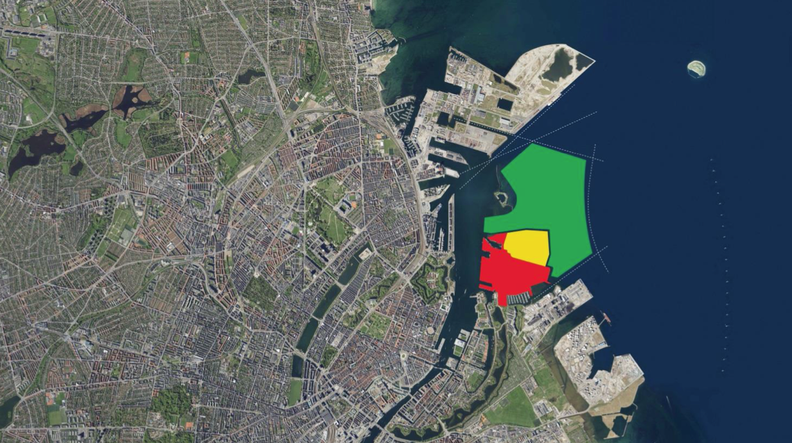
Lynetteholmen
In 2018, the Copenhagen City Council approved the agreement of building a new city district ‘Lynetteholmen’ in Copenhagen. Lynetteholmen will be located between North harbour (Nordhavn) and Refshaleøen (Northern Amager). The building project is expected to begin in 2035 and to be fully developed in 2070.
This new city district will facilitate different forms of mobilities; biking, cars and public transport (metro). Furthermore, Lynetteholmen will connect the North harbour to Amager through a new eastern ringway.
Funded by the EU Horizon 2020 programme

Slide 8
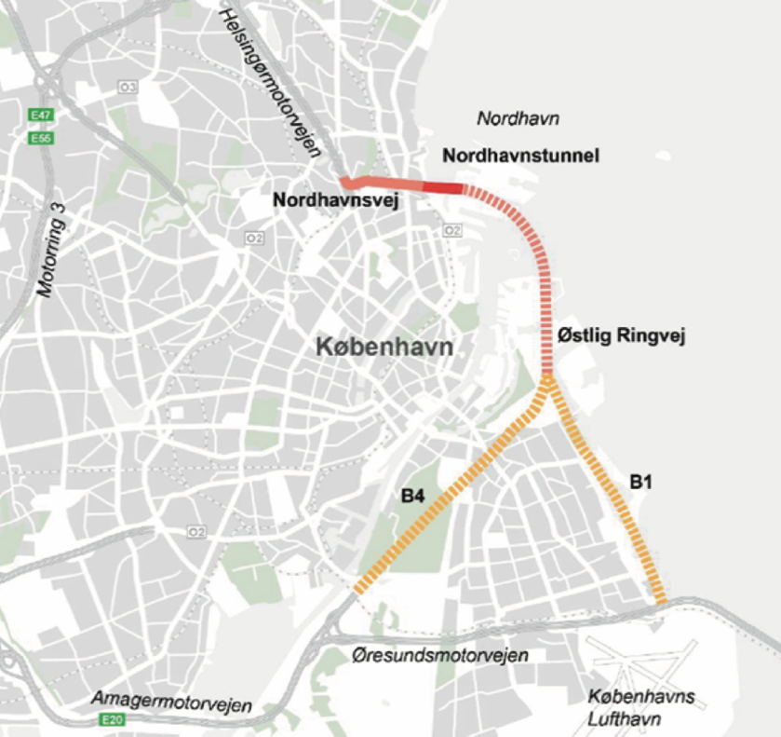
Eastern Ringway: The idea of the ringway is to combine the road system from north towards south by connecting the Helsingør-motorway to the Amager-motorway and Øresunds-motorway by leading it east around Copenhagen in a harbour tunnel (see map left).
North harbour tunnel: Another tunnel project in progress is the 1.4 km long tunnel connecting the inner and outer North harbour. The tunnel project has become a part of the Eastern Ringway project and is expected to be ready to use by 2027 (see map left).
Funded by the EU Horizon 2020 programme

Slide 9
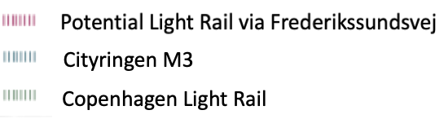
Light Rail via Frederikssundsvej
Plans of a new light rail is on the table, connecting Nørrebro station to Gladsaxe Trafikplads via Frederikssundsvej. It will cover a distance of 8.7 km, stopping at 16 stations. The potential light rail will combine the upcoming light rail on Ring 3 (cf. The Copenhagen Light Rail) and the City Ring (Cityringen - metro line opened in 2019 in inner Copenhagen).
Funded by the EU Horizon 2020 programme

Slide 10
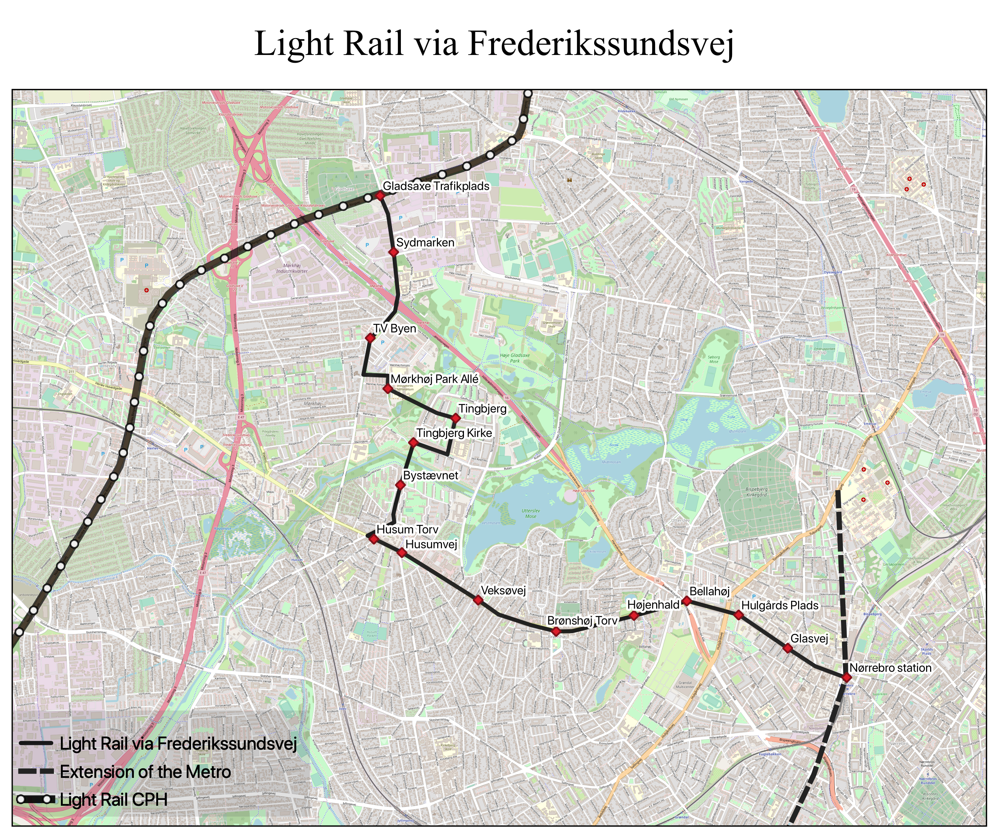
Funded by the EU Horizon 2020 programme

Slide 11
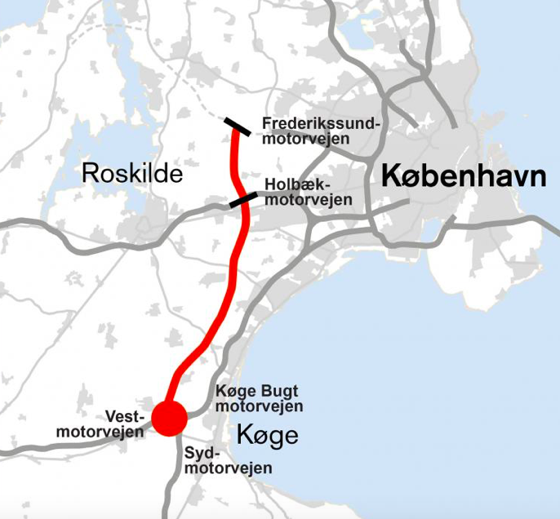
Ring 5 South (Motorway)
As illustrated on the map (slide 4) several new motorway projects are in the pipeline (e.g. the extension of both the Hillerød- and Frederikssunds-motorway).
The comprehensive Ring 5 project (western corridor), was initially thought to connect Helsingør-motorway to South-motorway. However, the project is facing financial and political obstacles and it is currently the southern part of Ring 5 which are in realisation (see map left).
Funded by the EU Horizon 2020 programme

Slide 12
References
Web 1: https://m.dk/vi-bygger-nye-linjer/m4-til-sydhavn/
Web 2: https://www.dinletbane.dk/da/
Web 3: https://www.trm.dk/media/3101/faktaark-om-lynetteholmen.pdf
Web 4: https://www.kl.dk/media/22077/kkr_faktark_oestlig_ringvej_140818.pdf
Web 5: https://www.kk.dk/sites/default/files/edoc/Attachments/21844690-29906107-1.pdf
Web 6: https://ing.dk/artikel/ny-motorvej-sigte-regeringens-ring-5-har-lange-udsigter-223430
Funded by the EU Horizon 2020 programme

